Slide 1

Vivekanand Education Society’s Institute Of Technology
Department Of Information Technology
Project Review 1
`
Title:
SCHOOL MANAGEMENT SYSTEM
Domain: Web Development
Group Members:
Member1 : MANISH MAKHIJA
Member2: RINKI TEJWANI
Member3: VANITA DARYANI
Mentor Name:KAJAL JEWANI

Slide 2
Content
Introduction to the project
Problem Statement
Objectives of the project
Requirements of the system (Hardware, software)
ER diagram of the proposed system
Front End
Expected output
Gantt Chart
Pending work
Conclusion

Slide 3
Introduction to Project
Maintaining and keeping track of school administrative activities is not an easy process in the fast-growing world. It requires hard work and often it is time-consuming.
To better perform the school administrative activities of educational institute and to assure parents the real-time progress and security of their children, educational institutes utilizes School Management software nowadays.
r Rates

Slide 4
Problem Statement
School Management System application offers many features that help to enhance the performance of schools with minimum efforts. School Management software does it by avoiding the manual paper works and automation of many academic and administrative activities that saves a lot of time.
r Rates

Slide 5
Objectives of the project
Management and Online Payment
To
To provide Student Information to teachers
Parent has access on child's activities
Attendance Management
Report Cards
Fee Management and Online Payment

Slide 6
Requirements of the system (Hardware, software)
Hardware: Ram 8 GB
Processor:AMD A12-9700P RADEON R7 10 compute cores 4C+6G 2.50 GHZ
Software: Windows version 10
lem hh
Problem Statement

Slide 7
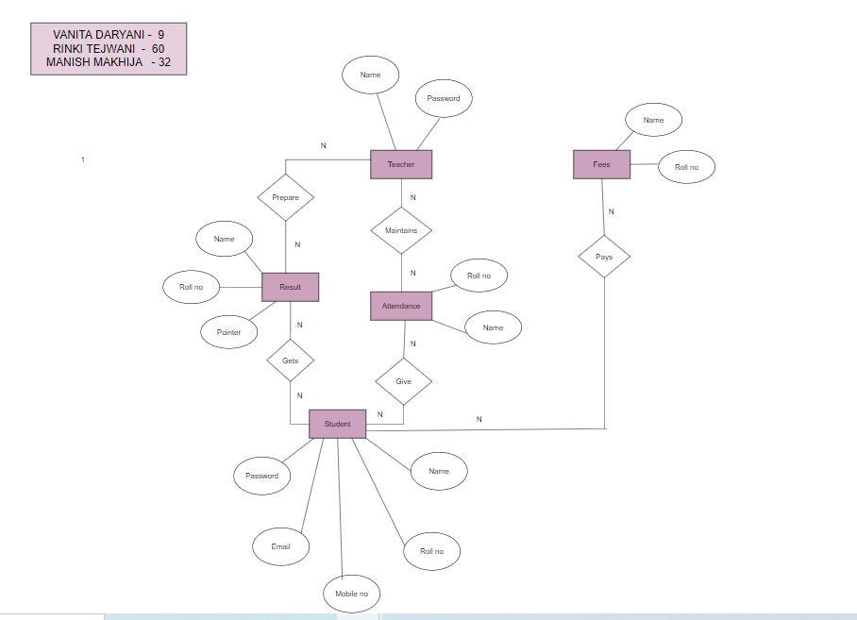
ER diagram of the proposed system
LINK:

Slide 8
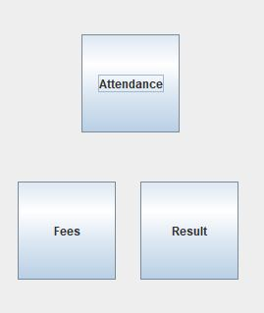
Front End
JAVA SWINGS

Slide 9
Expected output
The major outputs of project are...
. Student's enquiry
• Class's enquiry
• Fee's enquiry
The project subjected to information, user accounts and Class details.

Slide 10
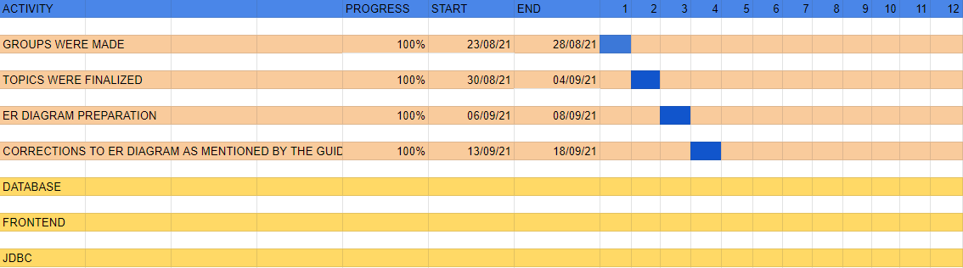
Gantt Chart
Notes:
The max flow algorithm in the visualization is :-

Slide 11
Pending work
1.Classrooms and facilities are incomplete
2.Teacher login and student login is complete.

Slide 12
Conclusion
Automation of these process makes the school administration effortless thereby ensuring the smooth functioning of the school.
Helpful to perform paperless work and manage all data
Provides easy, accurate, unambiguous and faster data access.

Slide 13
THANK YOU

